Slide 1
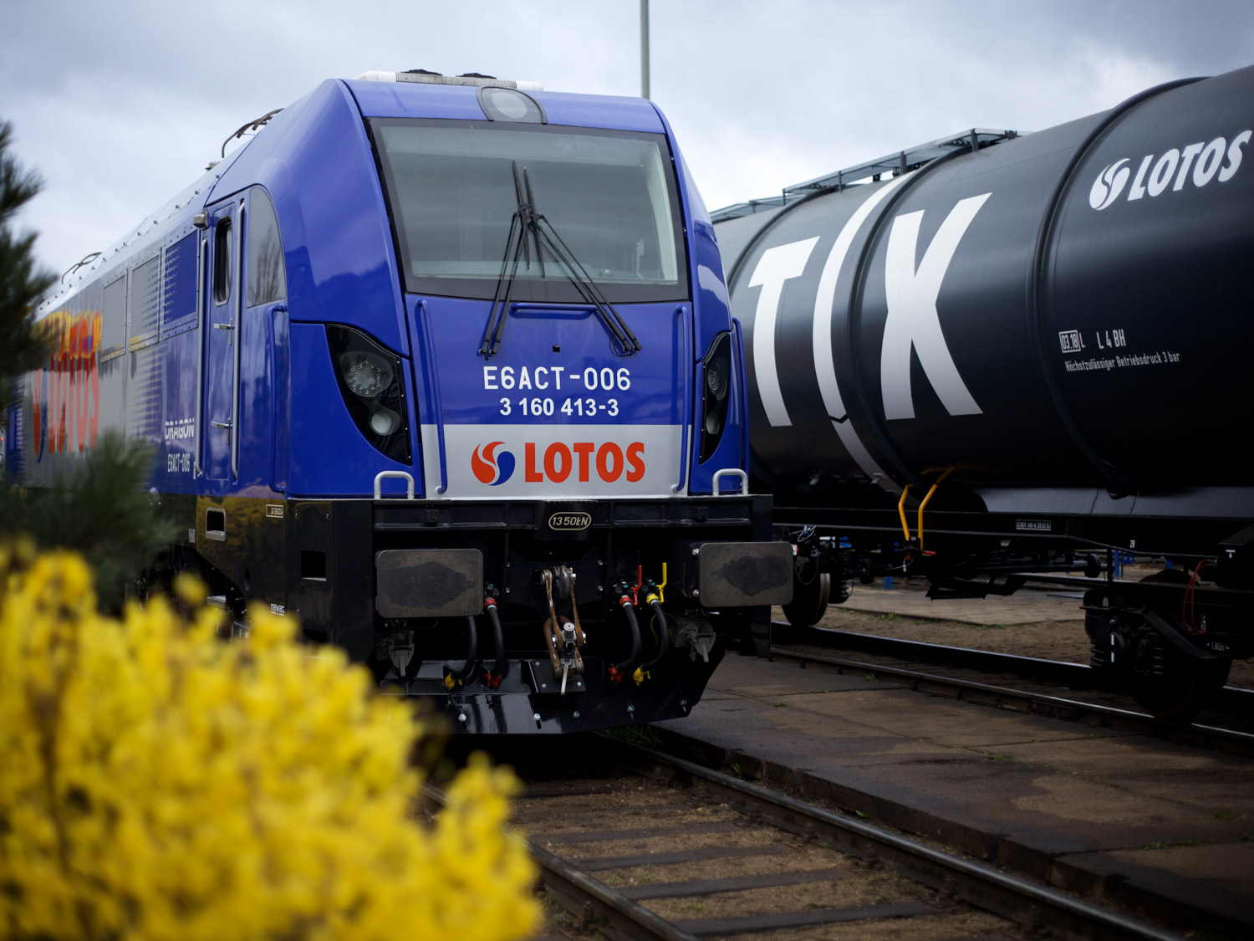

Presentation of the Company
LOTOS Kolej sp. z o.o.
8 czerwca 2016

Slide 2
GRUPA LOTOS S.A. is the sole owner of the company.
THE PRIMARY PURPOSE OF THE ACTIVITY is to provide a safe and efficient rail transport for companies of LOTOS Capital Group .
One of the few rail carriers with THE POTENTIAL TO HANDLE SINGLE CARLOADS
One of the two rail carriers with
THE POTENTIAL TO PROVIDE COMPREHENSIVE SERVICE OF THE LARGEST PLANTS

Slide 3
MODERN FACILITY FOR CLEANING OF RAILWAY TANKS which meets the highest EU standards in the field of ecology
In cooperation with foreign carriers, about 30% of transport operations is carried out within INTERNATIONAL TRANSPORT.
1
The LEADER in railway carriage of dangerous goods.
2
The SECOND largest rail freight carrier in Poland.

Slide 4
3
The SECOND largest rail operator in intermodal transport in Poland
Transport potential of approximately 12 m. tons/year
We employ 969 PEOPLE *
We currently use OVER 100 LOCOMOTIVES 4,000 CARS
* As of 1st June 2016

Slide 5



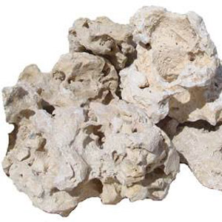
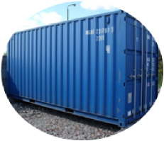

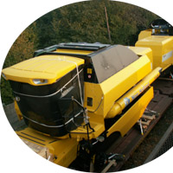
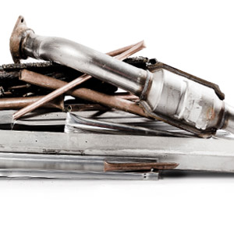
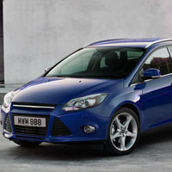



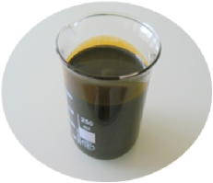
2003
2016
Customers:
- LOTOS Capital Group
Transported products:
- Petroleum products
Customers:
- LOTOS Capital Group
- Customers from the European Union
Transported products:
- Petroleum products
- Grain
- Scrap
- Metal sheets
- Steel
- Bio-components
- Containers
- Limestone
- Cars
- Harvesters
- Paper
- Other

Slide 6

Business segments
Transport services
  Carriage of goods
  Cooperation with shipping agents and rail carriers from EU and Eastern Europe
  Specialisation in the transport of petroleum products and chemicals
Management of railway sidings
  Comprehensive management of railway sidings
  Technical maintenance of railway equipment and infrastructure
  Railway traffic control equipment support
Rolling stock
  Lease of rolling stock
  Technical maintenance of the rolling stock
  Tanks cleaning

Slide 7
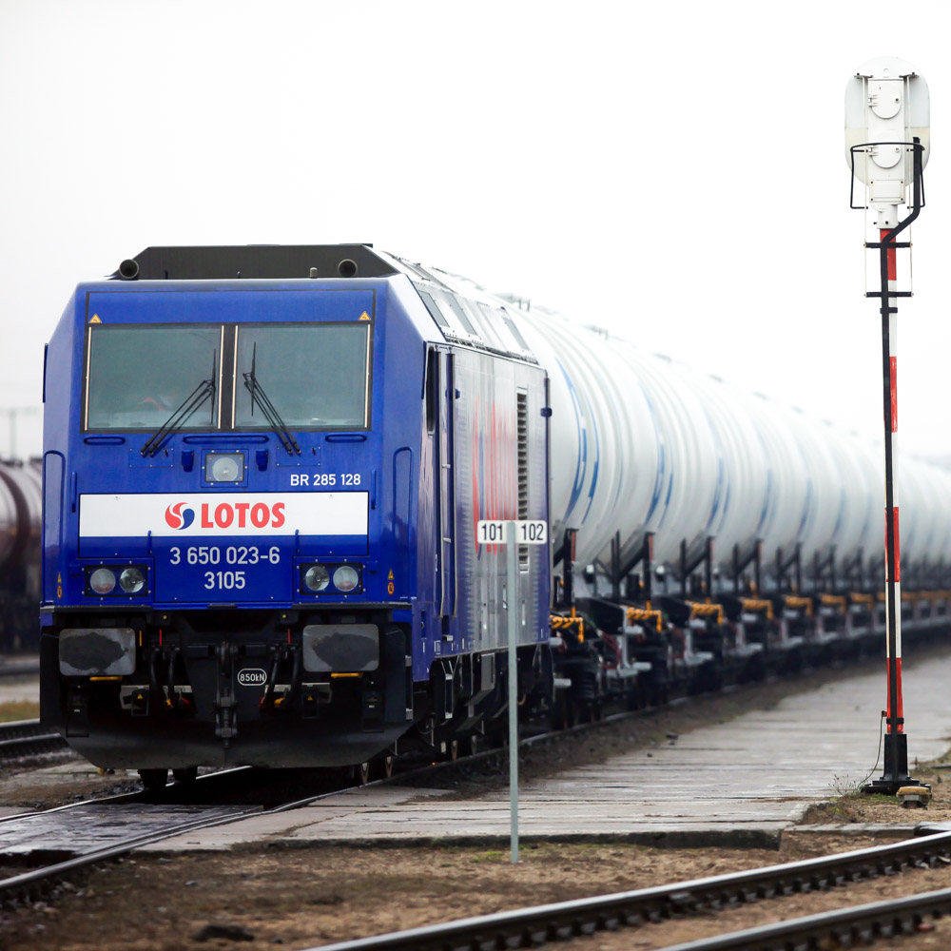
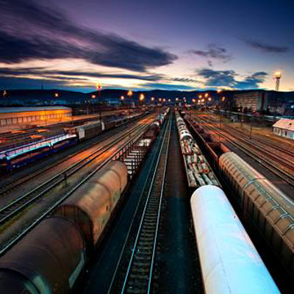
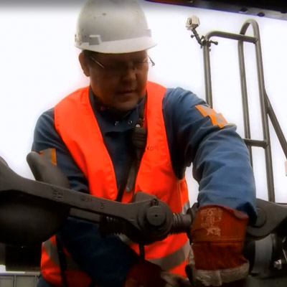
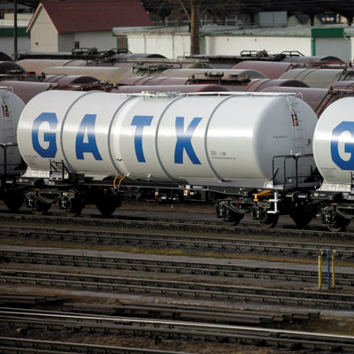
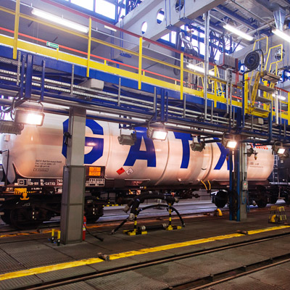
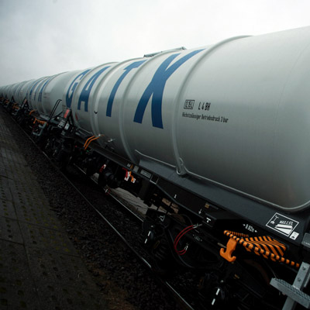
Comprehensiveness of services
Trainload
service
Single
wagon
transport
Freight forwarding
Providing access to
wagons
Technical service
of wagons
Cleaning
of wagons

Slide 8
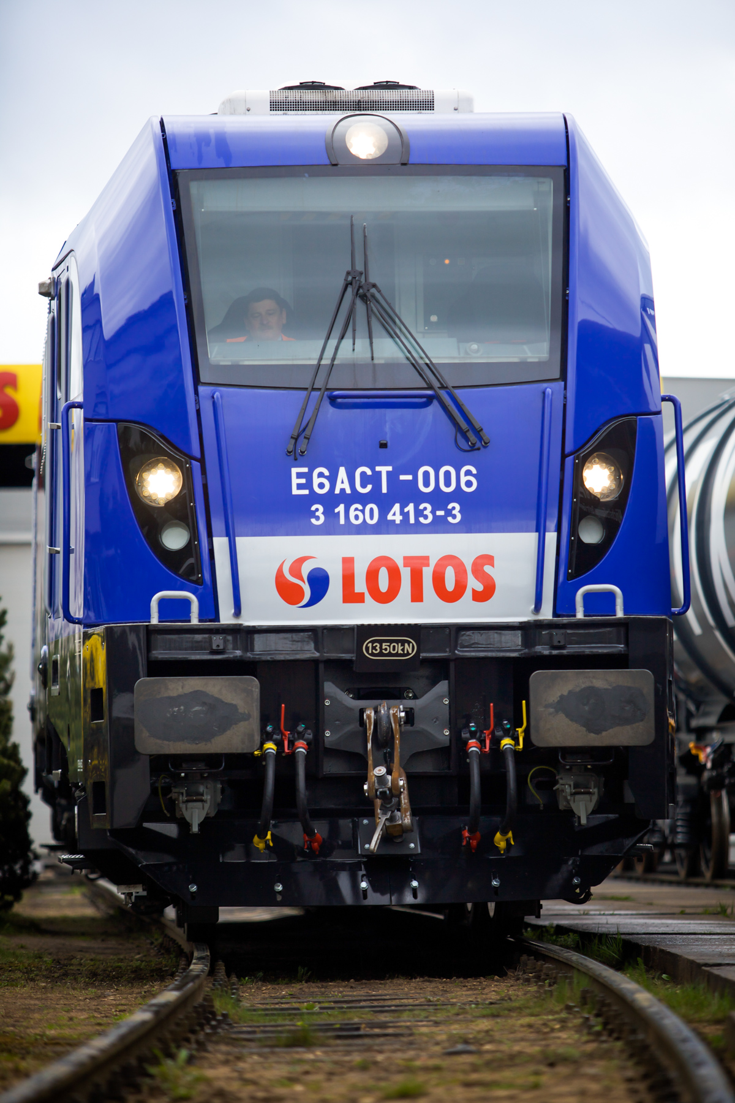
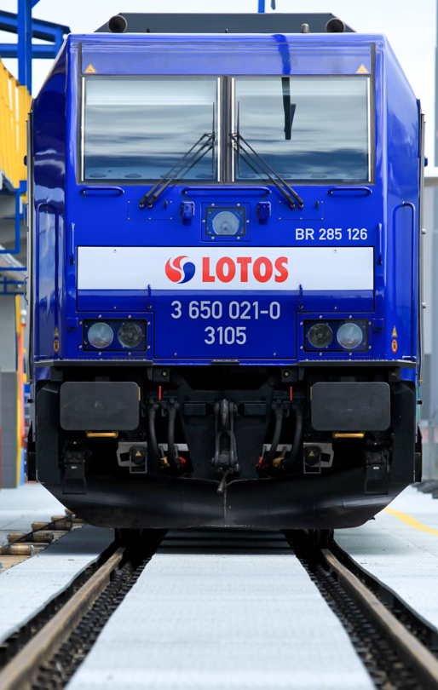
Quality and safety
Safety Standards
Railway Transport Safety Management System
Maintenance Management System
Safety and Quality Assessment System
Certificate of Safety & Quality Assessment System
ECM – a person responsible for the maintenance of the rolling stock
Quality and efficiency
Modern fleet - high availability
Unique IT solutions
Timeliness of supplies
Openness to the client
Flexibility – quick response to market needs

Slide 9


Innovative IT
Rail Logistic System (SLK) - our answer to market's needs
Electronic Client's Profile – LOTOS Tracker
Mobile Logistics System
planning and supervision of transport handling
and railway sidings management
SLK
real time monitoring of trains
preparation of transport documents
human resources management – transport of workers, payroll planning and processing
The system was built and implemented
from scratch taking into consideration company's needs
administration of rail traction units

Slide 10
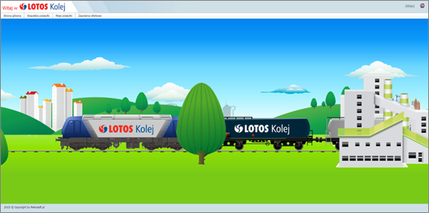
LOTOS Tracker - benefits for customers klient.lotoskolej.pl
Monitoring of the plan
and transport management
Stamped waybills
Control
liabilities
Status of commercial information preparation
Copying of queries
Data gathered
in one place
Shipment tracking
by contractors

Slide 11
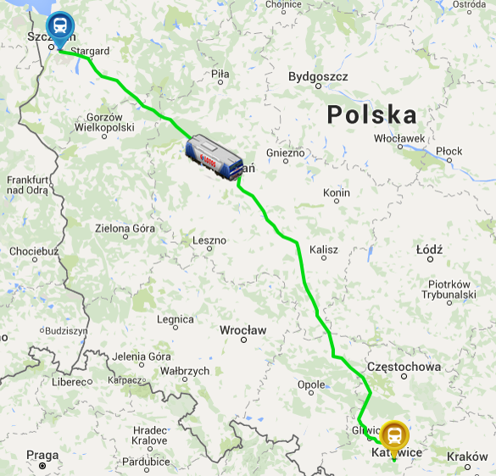
LOTOS Tracker - shipment tracking* klient.lotoskolej.pl
Monitoring
of the
timetable
Monitoring
of the completion
Planning
of a date
Real
dates

Slide 12
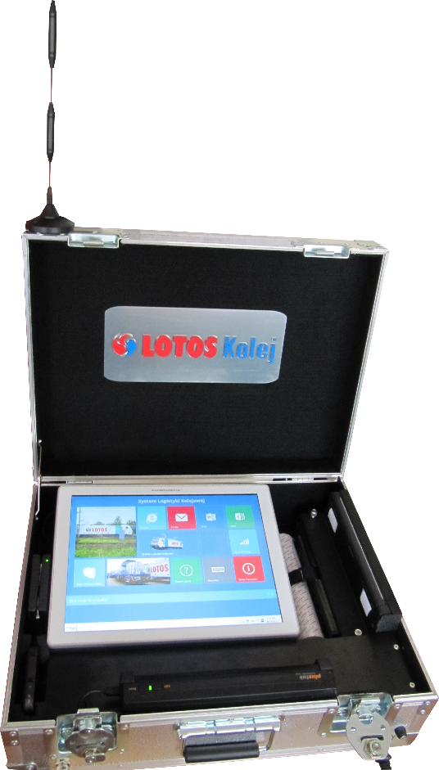
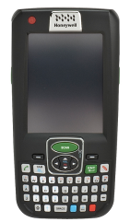
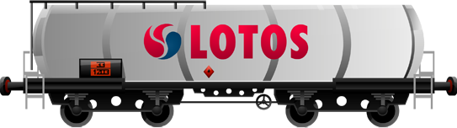
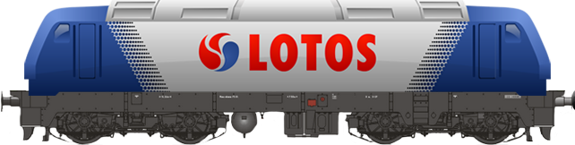
Mobile Logistics System
Mobile Logistics System:
create shipping and commercial documents out of office
record and control working time of train crew and shunting crew workers
print, scan and send electronically the documentation which you create
Mobile Logistics System uses industrial computers and mobile terminals, installed in all locomotives.

Slide 13
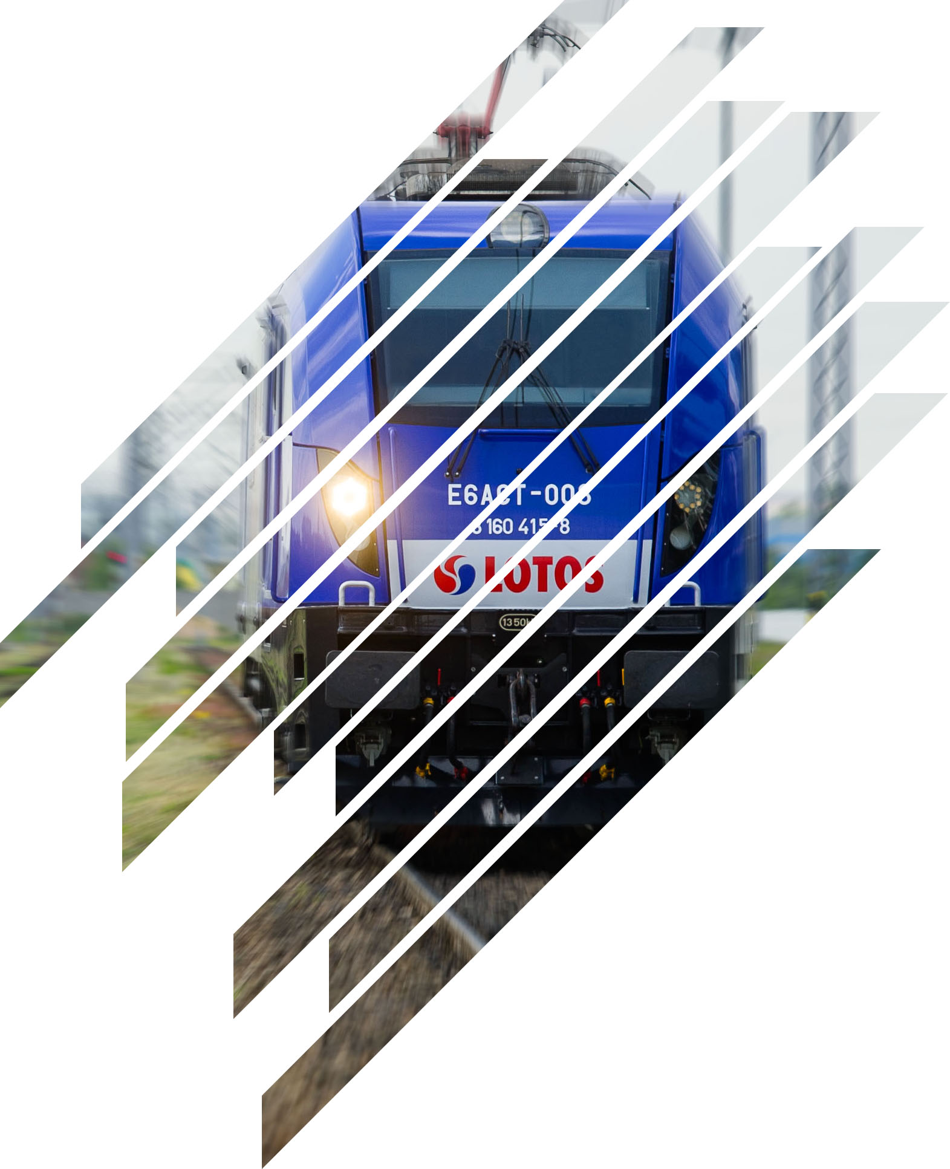

The key directions of transport
The average distance of LOTOS Kolej train carriage in Poland amounts to 418 km
Belarus
The Netherlands
Ukraine
Belgium
Czech
Republic
Slovakia
Austria
Hungary
Romania
We cooperate with public and private rail carriers in 18 EU member states and in Eastern Europe
Turkey
In cooperation with foreign carriers, we daily use 15-20 trains
13

Slide 14
The development of LOTOS Kolej compared to overall shipping market
The dynamics of Polish rail freight market as per rail freight performance
[bn ntkm, index 2004 = 100]
CAGR*
2004-2015
[%]
35.5
100%
-0.3
*CAGR – average annual growth rate
Since 2004, the company has grown by an average annual rate of growth at the level of 35.5%. During the same period, the market recorded a negative CAGR rate -0.3%
Since 2009, LOTOS Kolej developed at an average annual rate of 12.7%

Slide 15
LOTOS Kolej Sp. z o.o.
ul. Michałki 25
80-716 Gdańsk

